Slide 1
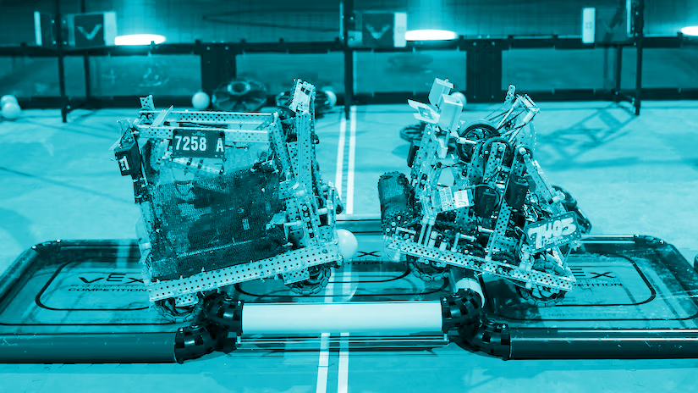
The
ULTIMATE
Beginner’s Guide For VEX Robotics
Created by Claire Shen

Slide 2
Welcome to Team 569,
Murrieta Valley High School Robotics!

Slide 3
NOTE
The following slides are arranged in order from the most essential resources (Basics) to more complex/deeper sources of information (Deeper Learning). It’s called a beginner guide but really it can be used by all skill levels :)
The specific role the information will be most useful for is also listed (Builder, Coder, Designer, General, etc.)
Let’s make it a great season!
= top picks

Slide 4
Basics - general
Before you can do anything in VEX Robotics, you need to know what this year’s game is! Here’s an embedded video of the 2023-2024 game, otherwise the link beneath it should show this current year’s game :)
https://www.vexrobotics.com/v5/competition/vrc-current-game

Slide 5
Basics - general
To work on a robot it’s essential to know the parts you’re working with! This video gives a description of all the most important VEX Robotics parts, their names, and how they’re used.
(warning: the kid talking in the background is me as an 8th grader!)

Slide 6
Basics - general
Kepler Electronics is a great resource that explains fundamental mechanisms in terms of VEX parts, as well as general advice for being on a VEX team. This is great information for any team member, but especially foundational for a builder/designer.
Vex Robotics Beginners Guide - YouTube (link)

Slide 7
Basics - general
B
The VEX Forum is where all robotics nerds convene to talk about aspects of the game. It is essential for any team member to look at the VEX Forum once in a while for fresh ideas, since it often has the most cutting-edge discussions and ideas. Especially useful to research design ideas (builders/designers), clarify game rules (general), and help debug code (coders).
https://www.vexforum.com/

Slide 8
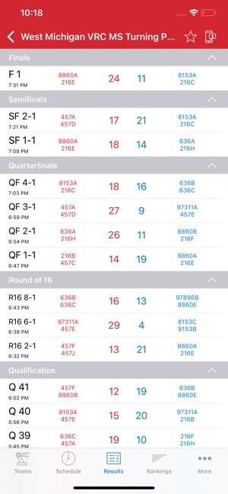
Basics - general
B
The VEX via app gives you real-time results for any VEX competition and is helpful for keeping track of the different teams’ rankings during tournaments! (sooo you should get it)

Slide 9
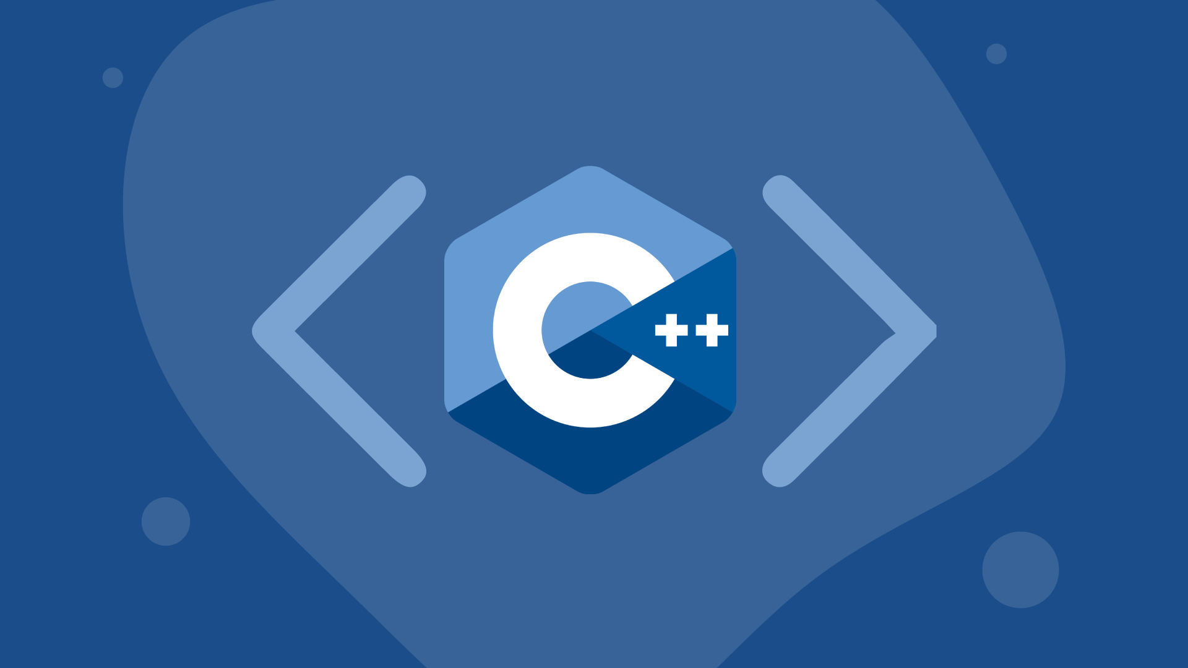
Basics - coder
W3 Schools is a great resource to learn how to code in C++, which is the coding language used in VEX robotics. These are great basics for anyone hoping to become a team coder. (also coding is a super useful career skill anyhow)
https://www.w3schools.com/cpp/default.asp

Slide 10
Somewhat Essential - general
The SIGBots Wiki is an incredible one-stop-shop resource to learn about all things VEX robotics (robot mechanisms, software, programming, even team dynamics!). It is created by a VEXU (university) team called the Purdue SIGBots.
Elimination Bracket - BLRS Wiki
this page explains the structure of robotics tournaments ^
Design Fundamentals - BLRS Wiki
https://wiki.purduesigbots.com/

Slide 11
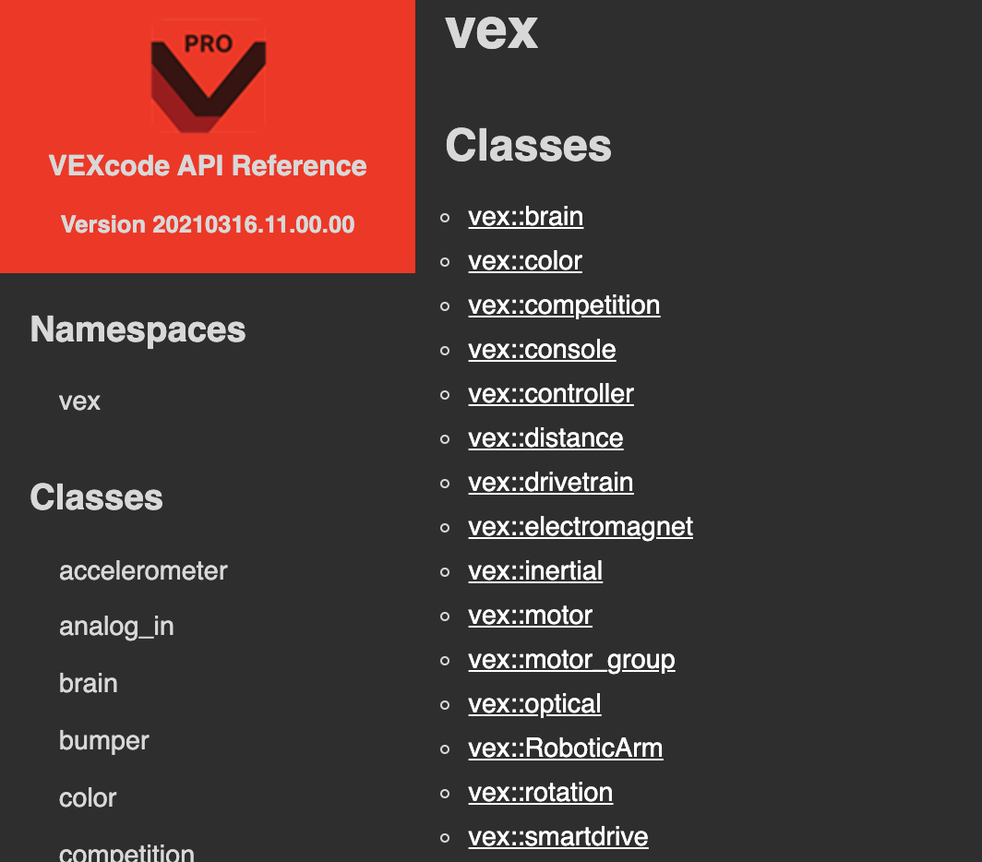
Somewhat Essential - coder
This is the library for VEXcode Pro. This resource which gives specific descriptions on the different commands within VEXcode. It is an essential resource for anyone who is certain they want to become a team coder. Do not use the scratch VEXcode Pro!
https://api.vexcode.cloud/v5/

Slide 12
Somewhat Essential - general
The VEX game manual is an in depth manual that describes all the specific rules of any given year’s game (... very very specific… hence the 100 pages). It’s a tough slog, but if you want a full understanding of this year’s game I suggest reading it – especially for building + strategy!
I have a version of Over Under (2023-2024) linked here… to find this year’s game just search it up & click the one posted most recently by VEX_GDC on VEX Forum
https://content.vexrobotics.com/docs/23-24/vrc-overunder/VRC-Manual-2324-1.1-Release.pdf

Slide 13
Somewhat Essential - builder/designer
SAS Robotics’ intro playlist to VEX CAD walks you through the beginning steps of learning how to CAD VEX robots in Fusion 360 in a nice & easy-to-follow way. CADing is a super helpful skill that any intermediate designer/builder should learn the basics of to add precision to their designs
Note: make sure to start from the first vid
Extra Note: SAS’s got advanced CADing tutorials too :)
VEX CAD Introductory Course – SAS Robotics

Slide 14
Deeper Learning - general (/designer)
The VEX robotics Discord server is much like an informal version of the VEX forum: its faster ‘n more personal. Note that it’s a bit of an avalanche of info – not needed for a beginner until you have a solid foundation of VEX robotics
Join w/ your name and 569 A,B,C,or D
https://discord.com/invite/vrc
Note: I personally most like looking at the videos on the “reveals” channel to look at the newest design concepts

Slide 15
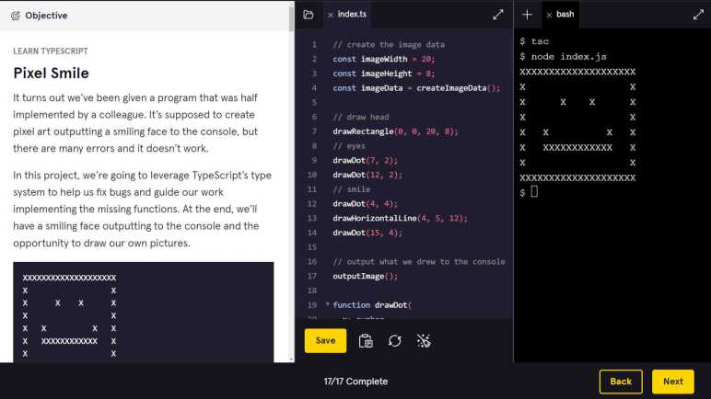
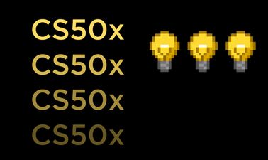
Extra Coding Resources
(‘cause it’s an important skill)
https://www.codecademy.com/
Codecademy’s a great resource for learning the basics of any programming language. It’s super user friendly and especially great for beginners. Only problem is its pricey – $19.99 per month for most functions (although there’s a basic free version)
https://www.edx.org/course/introduction-computer-science-harvardx-cs50x
Harvard’s CS50x Intro to Computer Science is a free, online version of the actual Harvard class – and comes with an official certificate thru edX! Hands down the best course to jumpstart skills in “real coding”. Although, it’s an extremely intense course so make sure you’ve got prior coding experience + lots ‘o determination & time
(the trailer b/c I love it)

Slide 16
Extra Coding Resources, cont.
https://www.coursera.org/
Coursera’s a great website to find coding courses that are put out by Universities at diff levels of difficulty. Also comes with certificates for resumes+LinkedIn.
https://www.kaggle.com/
Kaggle is one of the coolest resources I’ve found recently & the ultimate resource for anyone interested in machine learning (AI) models! It has massive, top-quality datasets, AI competitions with $$$ prizes, a forum, and courses for learning all things related to machine learning. Also free to sign up. Seriously – check it out!

Slide 17
Thanks for looking through this!
Shoot me an email at this gmail or talk to someone who has access if you ever think something should be added to this guide!
Honestly most of these resources I discovered only by asking people point-blank if they know any resources – which didn’t seem fair. I think anyone who wants to learn VEX should have the opportunity
I hope with collaboration and friendly gestures like this we can help make MVHS Robotics a more, well, collaborative and generally fun team! That’s how all the best teams work
Hope this helps ya out and inspires you to help a team member today!

Slide 18
Good luck in this year’s game!
Spin Up, 2022

